Slide 1
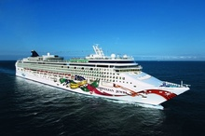
NCL Jewel 8/1/25 BOS BDA Bar Harbor BOS 8 Days/7 Nights
This is a BIG DEAL! Super Savings 10% discounted Cruise Fare plus lots more. Read on…
NCL August 1- 8, 2025 $1,874.05 BA Balcony Stateroom Standard Protection Policy $179pp Platinum Policy $239
$1,396.69 OB Oceanview stateroom Standard Protection Policy $139pp Platinum Policy $199
$50 deposit per cabin. Agency credit card. Final due 4/03/2025

Slide 2
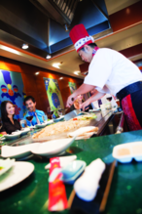
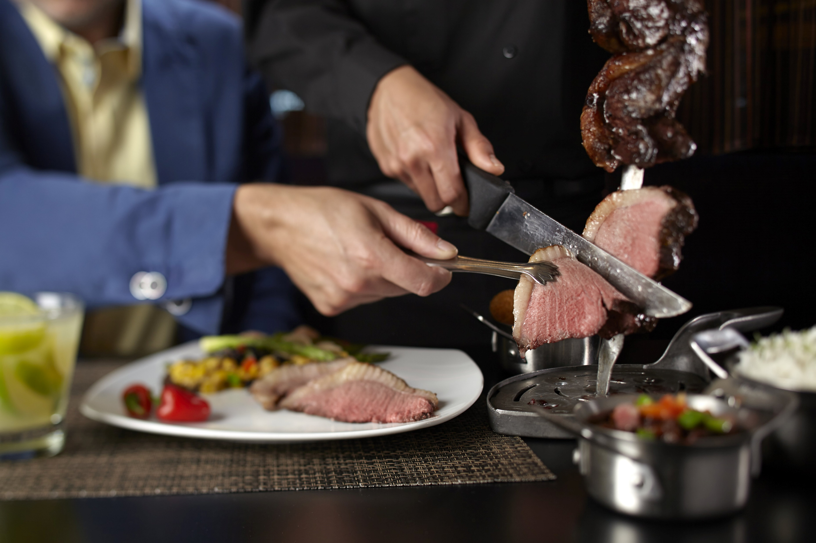
FOOD
We invite you to join us on a fabulous cruise aboard the NCL Jewel. Recently refurbished a cost that exceeds any other refurbishment. 13 Bars and lounges, 14 chic dining options to select from. whether it be Japanese Teppanzaki where food is prepared for you at your table with swinging knives and great entertainment. Sit at a lively shared table as a skillful chef perfectly prepares shrimp, steak, chicken and fried rice on a large steel grill. And you've got a front row seat to all the sizzles and surprises in our Japanese restaurant. There is the French Le Bistro Romance is in the air at our signature French restaurant. Elegant interiors, crisp white linens and attentive servers make this an intimate dining experience. By the end of your meal, you might just be proclaiming c’est magnifique!. There is also Cagney’s steakhouse to select from. Premium cuts are the standard at our American steakhouse serving Premium Black Angus Beef. Sip your favorite cocktail and don’t forget to order our famous Parmesan dusted truffle fries! Moderno Churrascaria -Looking for a unique experience? Our authentic Brazilian churrascaria is a must. Start with an impressive salad bar, but save plenty of room for our slow-roasted meats carved tableside by our Passadores.
Dine how and when you want and where your palate leads you with more than a dozen dining options. Discover the Main Dining Rooms, where the daily changing menus are as fresh as the ingredients, or reserve a seat at a specialty restaurant for a taste of something unique and unexpected. With no fixed dining times or pre-assigned seating and superb culinary experiences, nobody does dining like Norwegian.

Slide 3
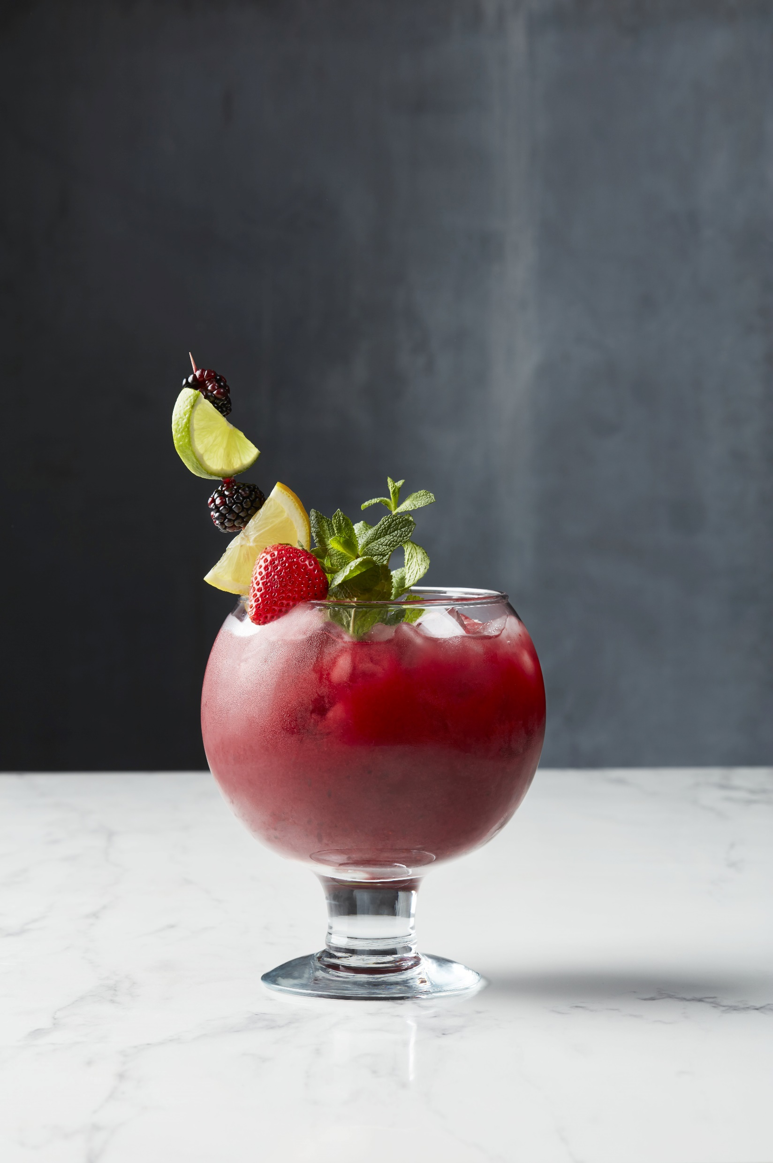
RELAXING
When it comes to relaxing, we have it onboard this floating oasis. Plenty of time on this cruise to sit back and relax as we saunter our way to Bermuda and back. From bow to stern, Norwegian has enough onboard activities to fill every minute of your cruise. Indulge in a refreshing swim in the pool or a relaxing dip in one of our covered hot tubs on the pool deck. Wanna get lucky? Bet it all at our award-winning Casinos at Sea®. And when all is said and done, enjoy a pamper session at the spa. With so much to do, we’ll always have you coming back for more.

Slide 4
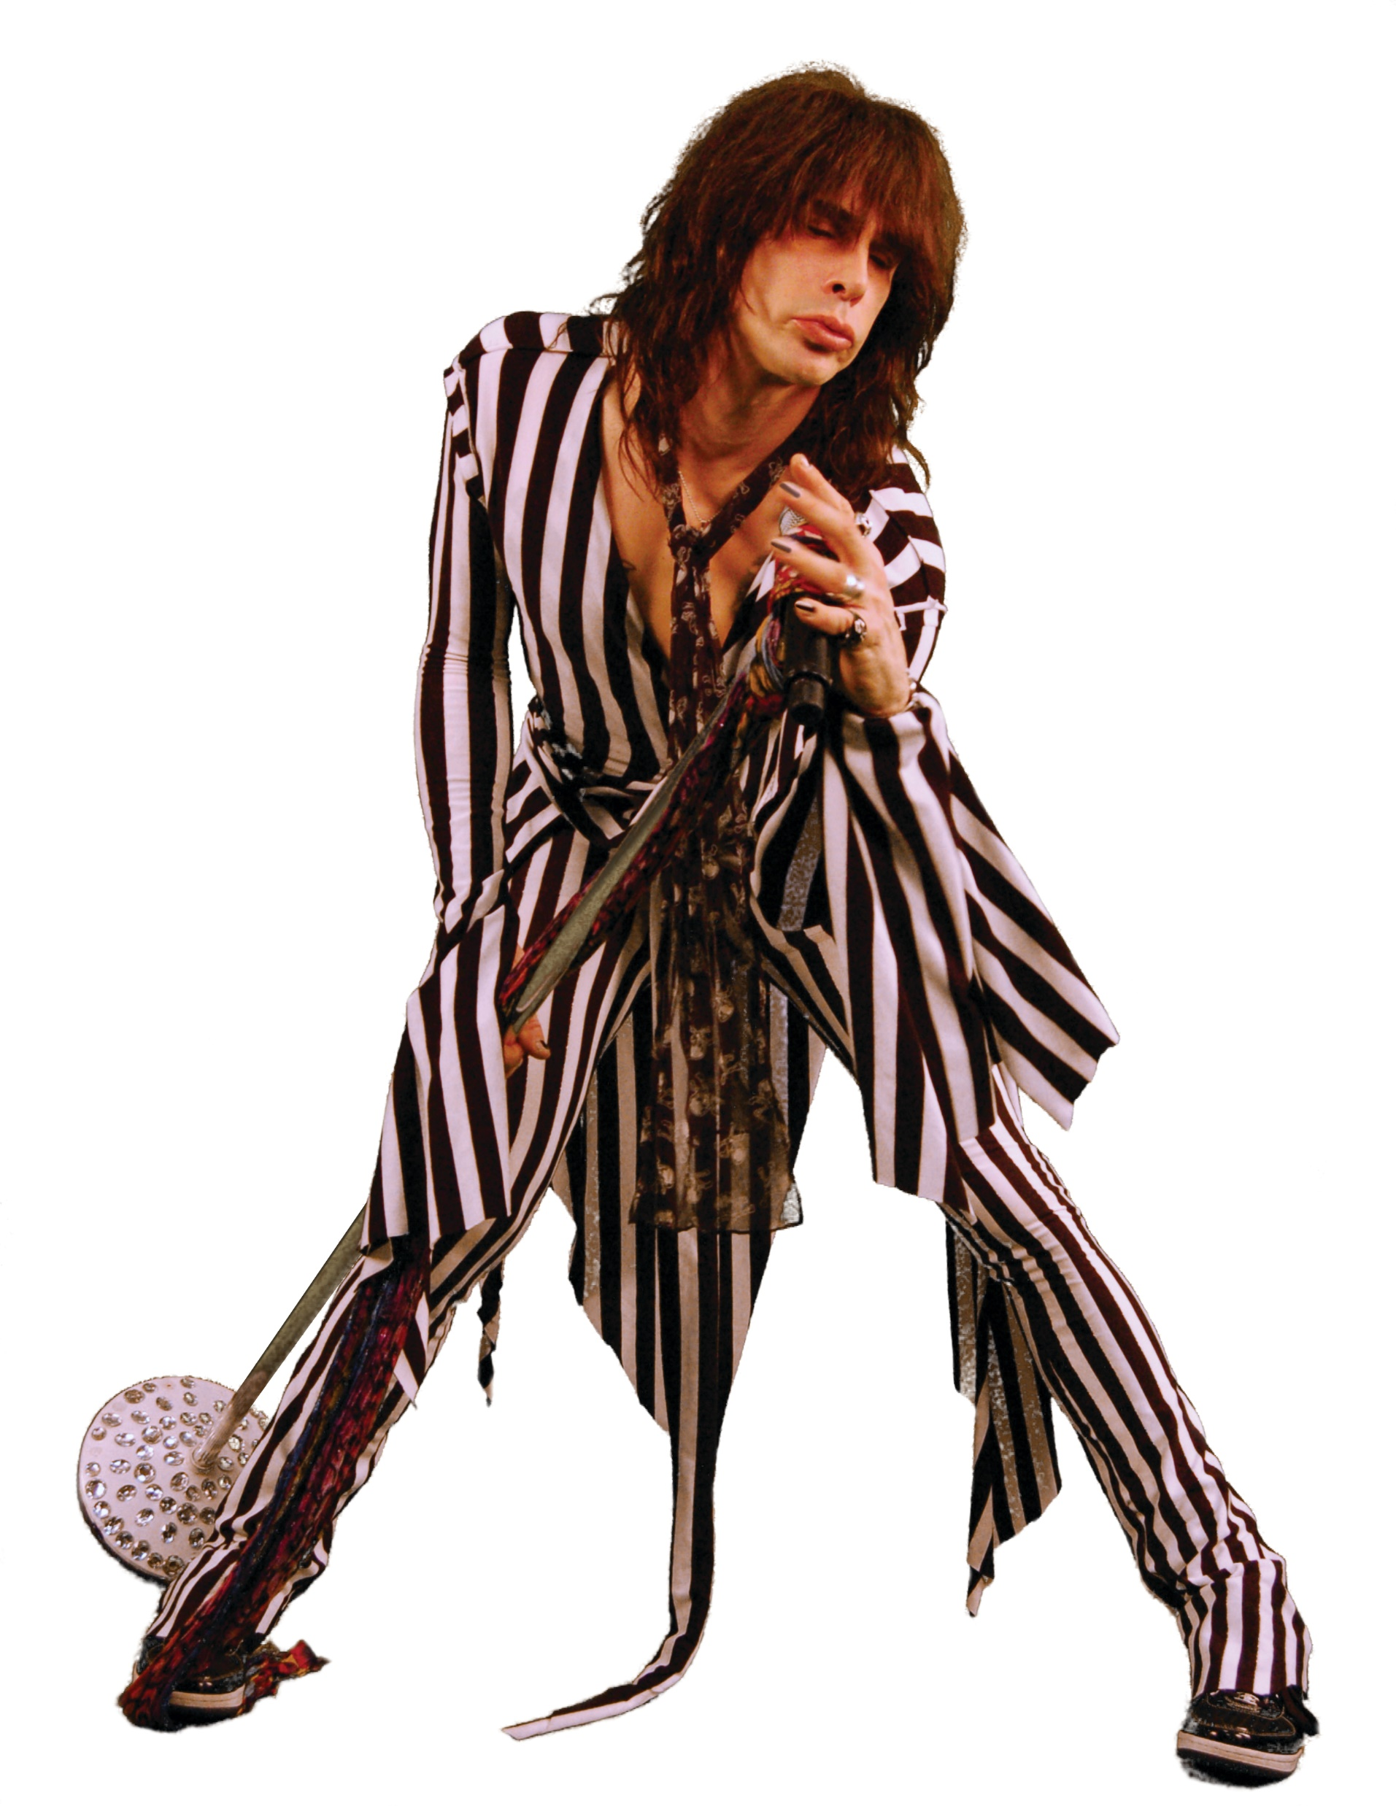
ENTERTAINMENT
When it comes to the entertainment on Norwegian Jewel, there’s never a dull moment. Get memorized by awe-inspiring acrobatics and immerse yourself in the magic of Le Cirque Bijou. Take a walk on the wild side at the production show Rock You Tonight, where the production cast combines with the Jewel Showband to bring you an explosive performance to rock icons Queen, Journey and The Who. Or simply grab a drink and join your Entertainment staff for our fun filled gameshows and parties, every evening. It’s showtime. All the time.
Entertainment! There is never a dull moment. The Jewel has it all. It’s showtime all the time! Every evening gameshows, parties and so much more.

Slide 5
Deal or No Deal
Enjoy an exhilarating show where contestants play & deal for cash in a high-energy contest of nerves and intuition.
Play cards will be available for purchase onboard.
Le Cirque Bijou
Complimentary
The Norwegian Jewel Production Cast takes you into a world where colorful jewels come to life. Immerse yourself in our circus where death-defying acts soar all around you and experience the magic of Le Cirque Bijou.
Exclusive to the Norwegian Jewel.
Rock You Tonight
Complimentary
Take a walk on the wild side in tonight’s production of Rock You Tonight! The high-energy grooves of our Jewel Production Cast combines with the rocking sounds of the Norwegian Jewel Showband to bring you an athletic explosion of dance that leaps off the stage to rock icons Queen, Journey, and The Who.
Wheel of Fortune
Wheel of Fortune is here! From Hollywood to the High Seas, experience this new interactive game show where everyone plays along on their mobile devices to solve puzzles and collect matches for a chance to win great prizes, including a Free Cruise! Watch the show or play along – everyone is invited.
Entertainment
Video Arcade
Stop by the video arcade and capture a few aliens, win a car race and fly a jet fighter.

Slide 6
The Library
You'll find a well-stocked selection of things to read with all the elegant trimmings a good library deserves including a stellar view.
The Chapel
This on-board chapel also functions as a meeting room.
Spa Thermal Suite
The Thermal Suite offers a unique experience benefiting the mind and body. Feel the weightlessness and total relaxation created by the kneading effect of water in the Thalasso Therapy Pool, or soak in the hot tub with friends for some improved circulation with conversation. Head off to the steam room to soothe joints and alleviate pains. If detox is what you crave, sit down at the sauna to sweat out your cares as your heart and sweat glands work together to purify your body. Then relax and bring your body to temperature with a nap on heated mosaic lounge chairs.
Sapphire Pools
The main pool on Jewel has a seemingly infinite number of sun beds and deck chairs to choose from. Topsiders Bar and a covered hot tub are all on deck, nearby.
Pulse Fitness Center
There are numerous ways to stay in shape while on board. The Pulse Fitness Center is open from 6am to 11pm with a full gym and aerobics/fitness classes daily.

Slide 7
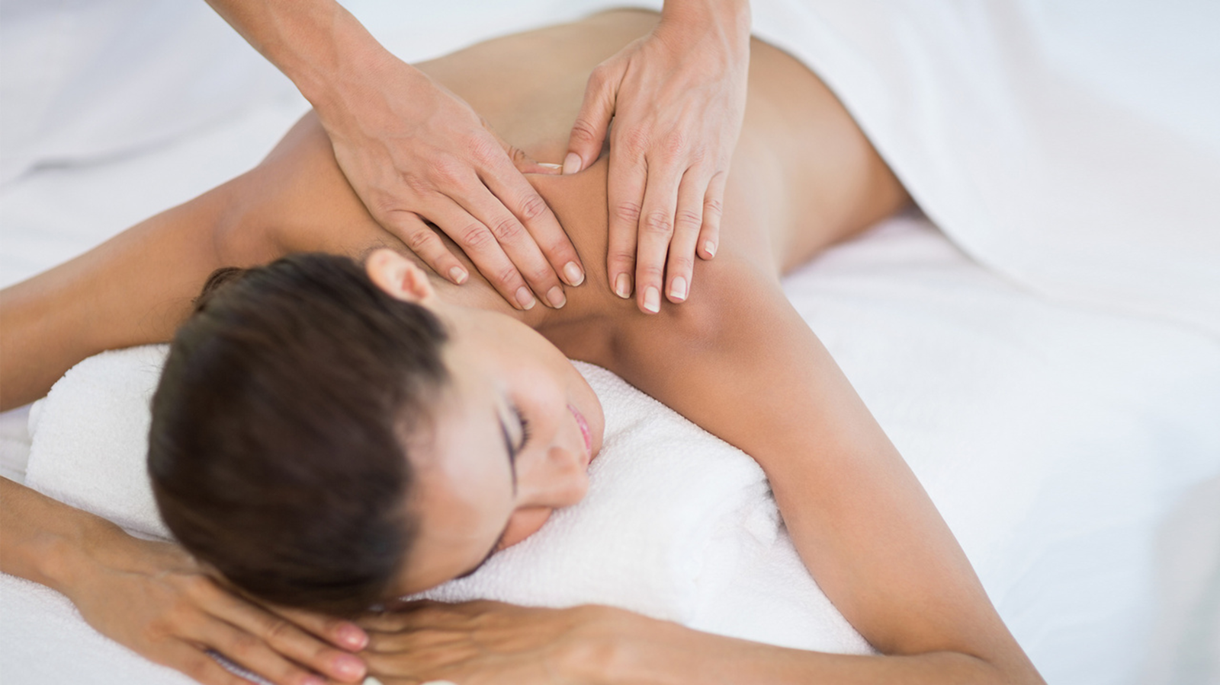

Slide 8
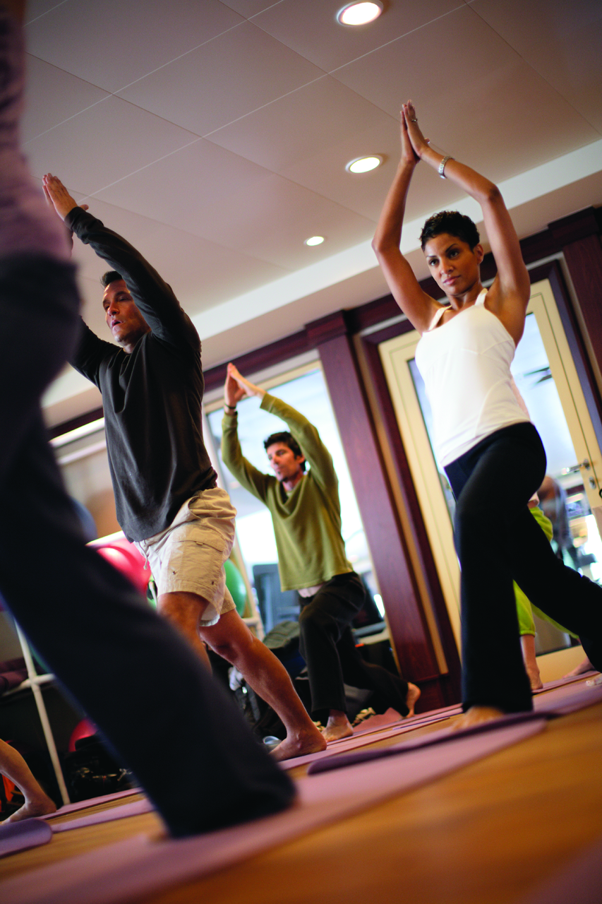
Jogging/Walking Track
Run circles around the other guests or get in your daily walk while you're at sea. Breakfast always tastes better after a good walk or run, right?

Slide 9
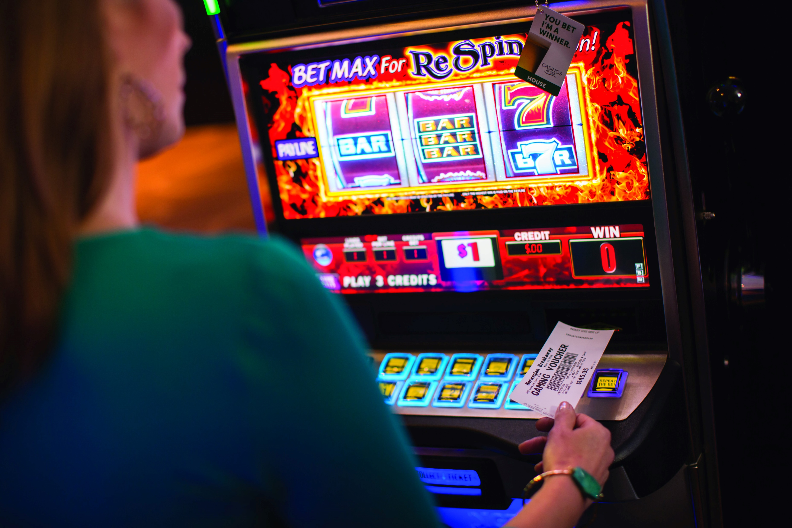
Jewel Casino
We’ve designed our casinos with comfort in mind so that you can relax and unwind while playing the most popular slots and your favorite table games. Whatever you play, get ready to ride a winning streak!

Slide 10
Internet Café
No matter how far you are from home, staying in touch is easy at the Internet Café.
Hot Tubs
There are six hot tubs conveniently located. Try them all out or pick your favorite and make relaxing and unwinding a part of your daily regimen.
Card Room
Here is one room where playing games is not just encouraged, it's expected. Find another couple and play bridge or test your skill with chess, checkers and Scrabble®.
Basketball/Volleyball/ Tennis Court
Shoot hoops, join a pick up game, play volleyball or tennis at the enclosed, outdoor Basketball/Volleyball/Tennis Court.
Art Gallery
Stroll through Norwegian Jewel’s Art Gallery of original works for sale by a wide range of well-known artists.
Professional Portraits
Take advantage of this time together while onboard to create beautiful photographs that will last a lifetime. Our professional photographers set up studios in the atrium and around the ship each night so you can have a variety of images to choose from. Relax, have fun and build your digital portfolio – it’s always free to try!

Slide 11
Bliss Ultra Lunge & Night Club - A lounge inspired by all things spherical and out of space. Bubbles, the use of lighting, color and ultraviolet artworks will be throughout this room.
Spinnaker Lounge - At night, the atmosphere at the Spinnaker Lounge is charged when the music comes up and the stage becomes a dance floor.
O'Sheehans Bar & Grill - Dine on reinvented Irish pub classics while sipping your favorite draft beer, all in a casual atmosphere open 24 hours a day. There's no cover charge to dig into your favorite comfort foods and savory Daily Specials, such as Prime Rib and all-you-can-eat Ribs, while taking in a sports game.
Magnum' Champagne & Wine Bar - Imagine Paris in the 20's. Magnum's is an inspiration of French Art Deco and the décor of the grand old cruise liner Normandie.
Maltings Beer & Whisky Bar - Inspired by the lobby bar from the Mandarin Oriental in London, this contemporary full bar has low lounges and tables with the perfect hint of mood lighting.
Shaker's Martini & Cocktail Bar - How do you like your martini? Shaken, not stirred? Of course you do. James Bond silhouettes reflect back at you from a screen behind the bar in this Art Deco inspired ode to the 1960's and 70's.
Sugarcane Mojito Bar - Freshly muddled just the way you like, enjoy a refreshing mojito with friends – day or night.

Slide 12
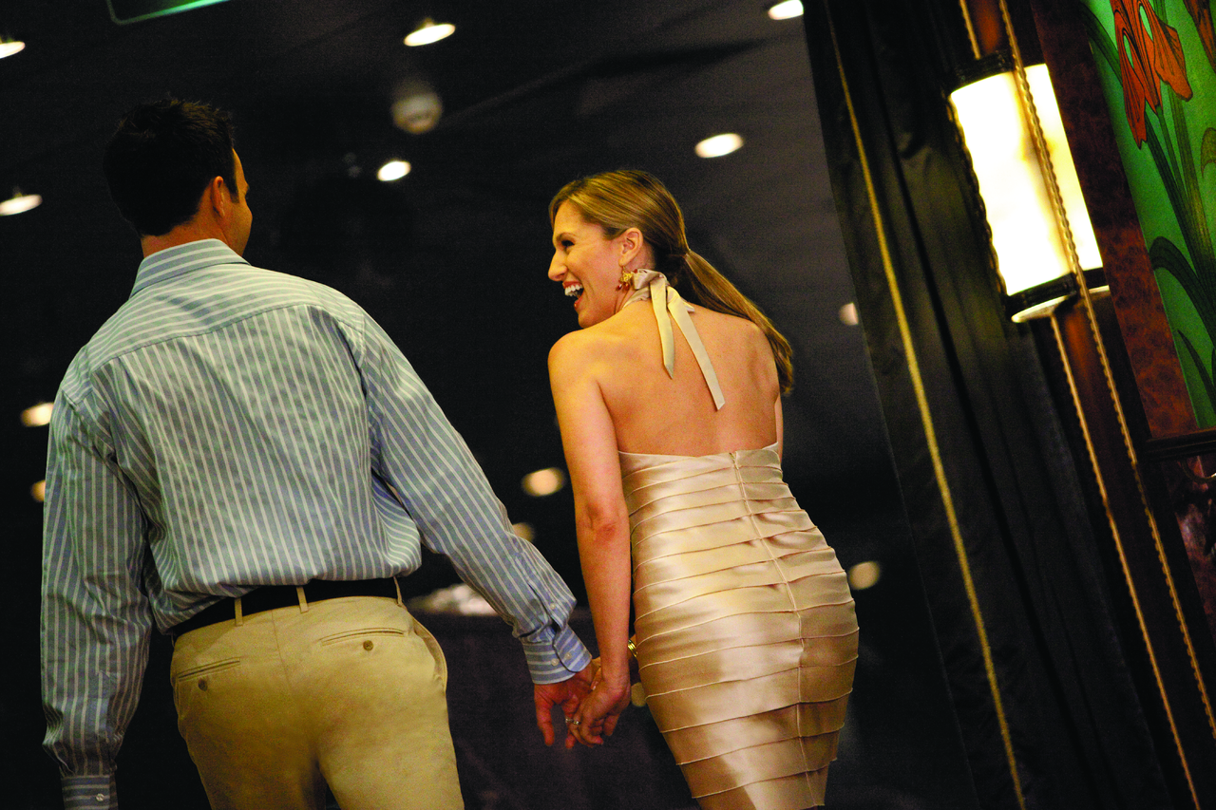

Slide 13
Wait – There is so much More At Sea for you and our group with this special package. It includes: Free unlimited bar – Free specialty dining (at 2 fabulous restaurants)– Free WiFi, $50 off shore excursion credit. Exclusive, inclusive and FREE’
• 8 Day/7 Night Cruise On Board NCL Jewel
Group has a 10% Discount on fare. PLUS $35 discount pp.
FREE Unlimited Open Bar – Includes alcohol, fountain soda & juice throughout the cruise. $15 beverage cap.
FREE Dining - Specialty Restaurant package – 2 meals. 7 Nights (Balcony and above) for guests 1 & 2. 1 Meal/ Studio, Inside, Oceanview $59pp value tax - $11.80 per package. 2 Meals/ Balcony & Above $99 pp value - Tax $19.80 pp.
FREE Excursions - $50 discount off first mate in booking. Unlimited excursions
FREE WiFi - 150 minutes per guest 1 & 2. One login per guest that can be used on 1 device at a time. – powered by Starlink. Includes activation fee.
FREE CruiseFirst Pay $150 and CFCredit of $300
& Free Onboard Welcome Surprise! Pricing not guaranteed until booked.

Slide 14
Package B: /$50 shore excursion/10 photos/Internet
Double in Group
BA $1,874.05 & $140 & $152.60 & $19.80 = $2,186.25 pp
OB $1,396.49 & $140 & $152.60 & $11.80 = $1,700.89 pp
IB $1,247.22 & $140 & 152.60 & $11.80 = $1,551.62 pp
Solo in Group
BA $3,421.17 & $140 & $152.60 & $19.80 = $3,733.57
OB $2466.45 & $140 & $152.60 & $11.80=$2,770.85
TPI BA Standard $179, Platinum $239/ OB Standard $139, Platinum $199.
Optional travel protection insurance. Click here for more information. https://www.ncl.com/freestyle-cruise/booksafe
Name Changes: up to 120 days from sailing (restrictions apply).

Slide 15
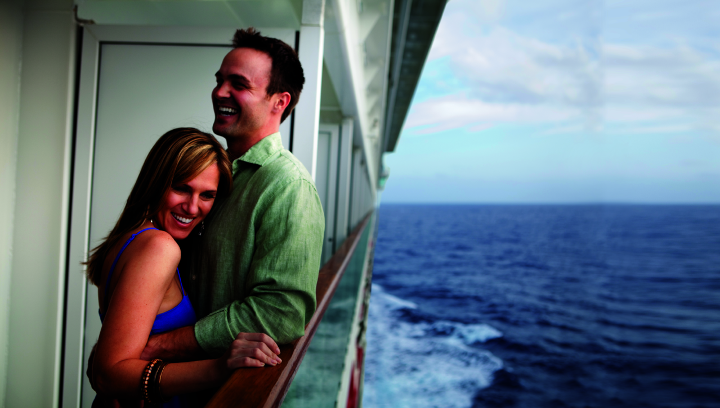

Slide 16
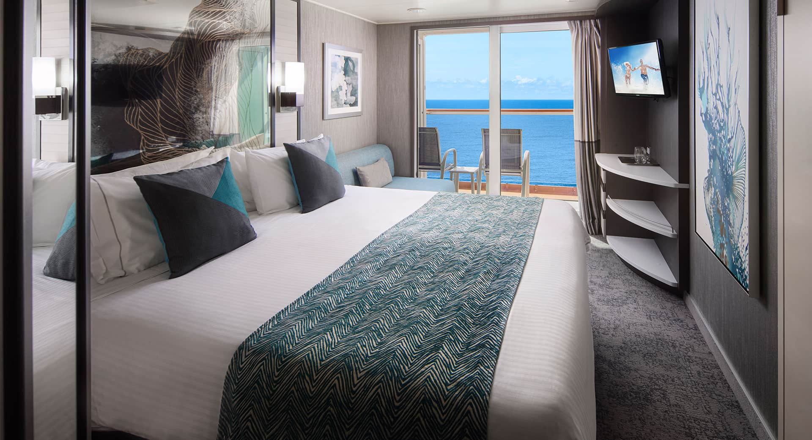
Balcony
Balcony staterooms come with two lower beds that convert into a queen-size bed, with some featuring one pullman or one single sofabed to accommodate an additional guest. Also includes a sitting area and floor-to-ceiling glass doors that open to a private balcony. Some can connect, a great option when traveling with family or friends.
Accommodates: 3
Total Approx. Size: 200-289 sq. ft.
Balcony Size: 38-54 sq. ft.
Decks 8,9,10 Forward, Mid, Aft

Slide 17
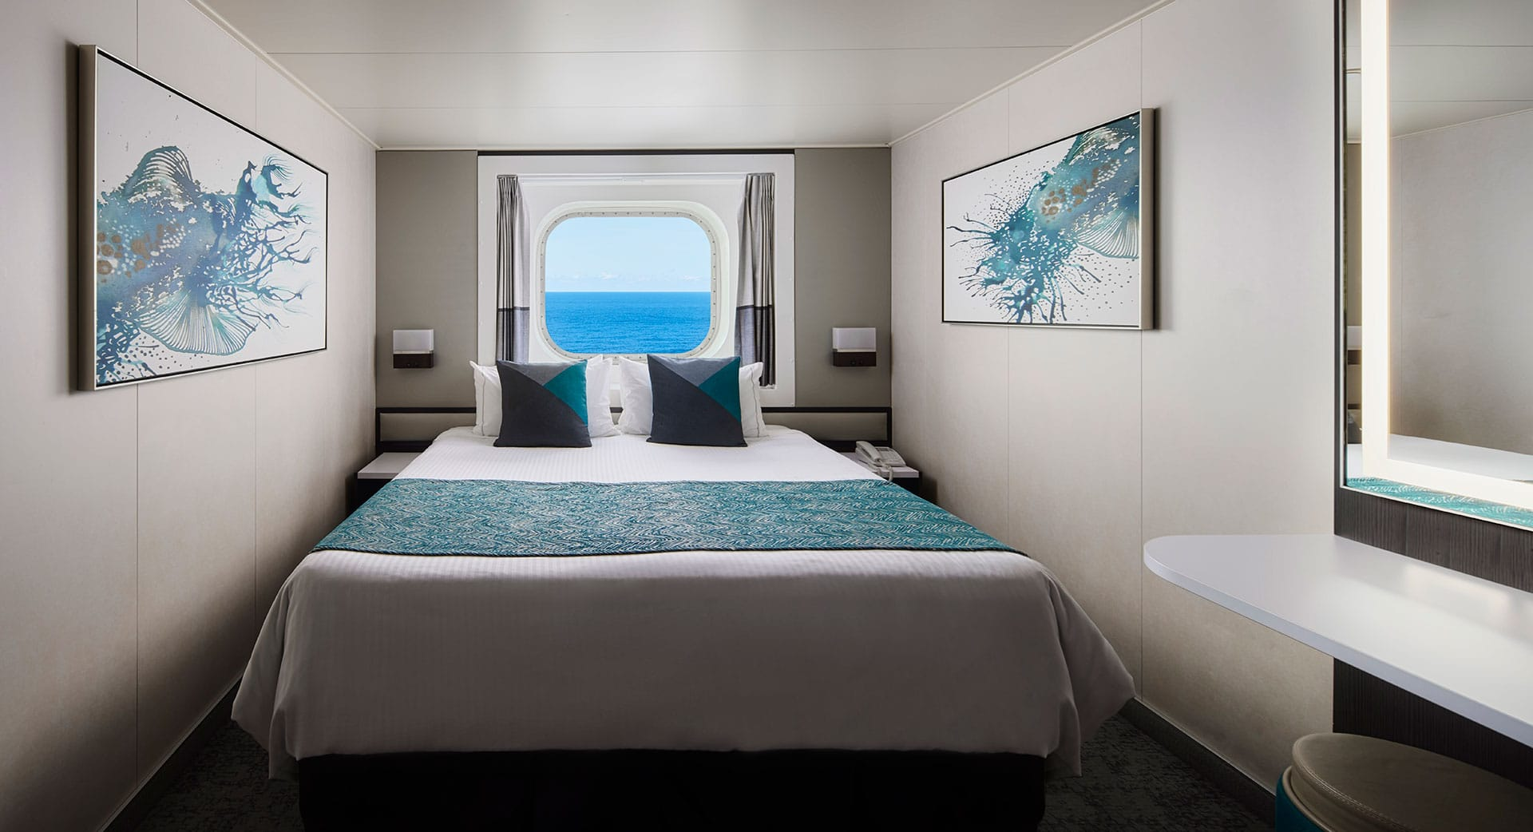
Oceanview with Picture Window
These comfortable staterooms accommodate up to three guests, making them ideal to kick back, relax and enjoy an amazing view from the big picture window. Two lower beds convert into a queen-size bed, and some have additional bedding for one more. Of course, you'll have room service and many other amenities. Some also can connect so you can spread out even more.
Accommodates: 3
Total Approx. Size: 138-161 sq. ft.
Deck 5,8 Forward, Mid, Aft

Slide 18
Many other cabin categories. Inside, mini suites, obstructed, The Haven.
10% Military Discount/ 5% discount and $50 onboard credit for teachers
NCL is credited with creating the Free Spirit Freestyle Cruises. Experience Freestyle Cruising
Imagine cruising just the way you want it: with no schedule to follow but your own. That is what Norwegian's Freestyle Cruising provides for all our ships and itineraries. Indulge your taste buds at one of our wide-ranging dining options, with no set mandatory dining times or perhaps you would prefer a dinner and a show combination? Relax at some of the most spacious and modern staterooms in the cruise industry before venturing out to experience the shore excursion of your choice.
Attire is resort casual.

Slide 19
Itinerary Friday, August 1, 2025 to Friday, August 8, 2025 8 days on the ship
Day 1 Depart Boston. All aboard by 2pm. Ship sails at 4pm.
Day 2 At Sea
Day 3 Bermuda. Royal Naval Dockyard 9:00am
Day 4 Bermuda
Day 5 Bermuda. Depart 3:00pm
Day 6 At Sea
Day 7 Bar Harbor, Maine 9:00am-6:00 Tender Port
Day 8 Boston Disembark 7:00am

Slide 20
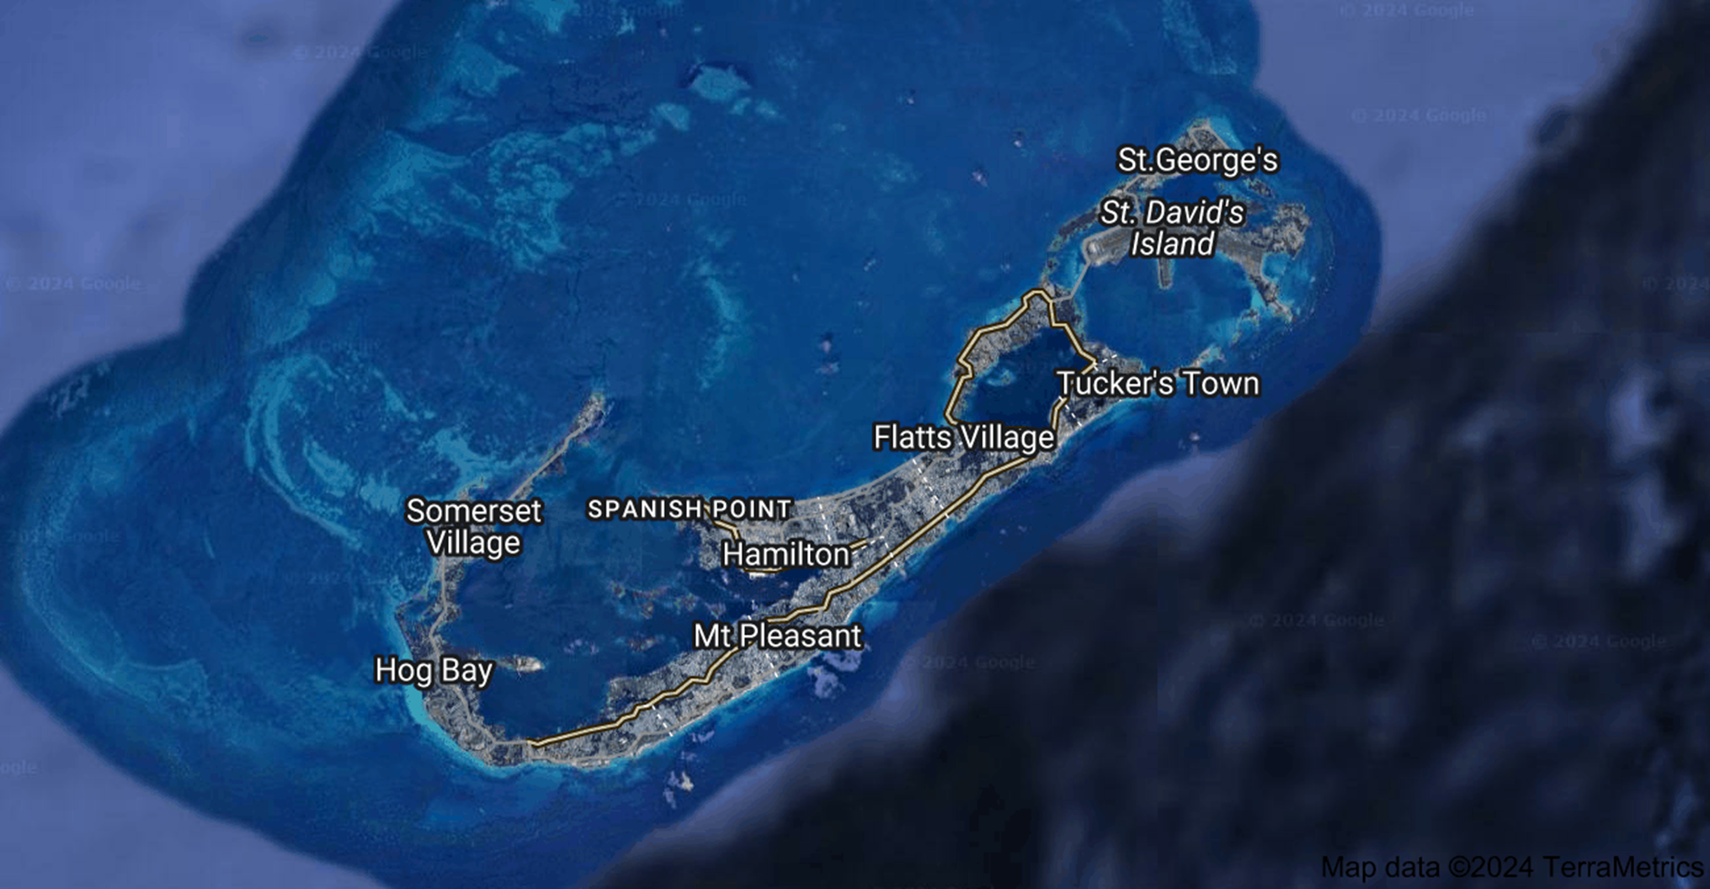

Slide 21
Required Travel Documents & Restrictions
PASSPORT - A valid government issued passport is required for this trip, and must be valid for 90 days AFTER the date this trip returns. *BEFORE BOOKING, PLEASE ENSURE THAT YOU PROVIDE YOUR LEGAL NAME AND DATE OF BIRTH AS THEY APPEAR ON YOUR PASSPORT. Errors in passenger information can result in your being denied boarding privileges.
Barry Brokerage is not responsible for guests being denied boarding due to their inability to meet required mandates to sail. Nor is Barry Brokerage responsible for information submitted incorrectly that may result in denial of boarding the ship.
Here are some important details regarding the finalization of your cruise booking once it is completed:
What is a Guarantee Cruise Booking - Any customers receiving a confirmation from our office with a Cabin Number that begins with a "GTY" means that you are guaranteed that cabin category or better on the ship. It means the ship is getting full and the cruise line would only guarantee you that category or better.

Slide 22
Final Payment – Please be reminded that failure to submit final payment on time may result in automatic cancellation and subsequent cancellation fees.
Online Check in Form – Please note that Norwegian Cruise Lines & U.S. and International Customs Authorities require accurate completion of the Online Check in Form. Please complete this form at least 21 days prior to trip departure. To complete the registration process go to www.ncl.com. Click on “REGISTER” in the upper right hand corner of the page if you have not sailed with NCL before or did not provide your latitudes number. For customers that have sailed with NCL before and have an existing latitudes number Click on “LOG IN” in the upper right hand corner of the web page. Follow the prompts from there to complete the registration. You will need your reservation/booking #, which will be emailed to you from our office once a cabin has been assigned. You will need to provide NCL your passport information as well as other pertinent personal information. Once you have logged into your account and have provided the necessary guest information you will also be able to do other tasks when logged into your account such as:
Reserve your table at specialty dining restaurants
Receive exclusive email updates, deals, and insider tips
Explore and book shore excursions before they fill up
Book seats for entertainment, spa services and other onboard activities
Check in online and prepare your boarding eDocs to save time at the pier
Access your itinerary, cruise history and Latitudes Rewards Account information
Latitudes rewards for previously sailed passengers. 1-20 points unlimited open bar package 30%, duty free shops 10% discount; Silver 20 points, Gold 45 points, Platinum 7t5 points, Saphire 150 points, Diamond 350 points.
Final Documents - Please note that all of your final boarding documents will be available for you to print out on-line approximately 3 weeks prior to the sailing date.

Slide 23
This is Bermuda.
Our country is pink-sand beaches and party boats, the smell of cedar and spice berries, the sound of gombey whistles (Gombey is a performance art that includes dance, drumming, and masquerade, and is a well-known symbol of Bermuda)., kiskadees, and clacks on a Crown and Anchor board. An island vibe unlike anywhere else.
Expect warm welcomes and big smiles. Natural wonders and exhilarating adventures. We are 21-square-miles of breathtaking beauty, blended cultures, and a hint of mystery. An Enchanted Island
Descend a stone staircase into a hauntingly gorgeous subterranean world in one of Bermuda’s underground caves, thought to be millions of years old. Take a stroll, a jog, or a bike ride along the coastal Rail Trail, marvel at the colourful Bermuda Arboretum, or venture into a lush green jungle . Hiking & Biking Pedal or hike along nature reserve trails, sandy beach paths or the historic, island-wide Railway Trail. Stroll lush, peaceful trails in Tom Moore’s Jungle or navigate rocky cliffs at John Smith’s Bay and Astwood Cove. One Small Island, Many Paths To Paradise Brilliant blue waters, powdery-soft pink sand beaches, stony cliffs and rocky coves connected with bays, preserves, marshes, grottos, and caves: Bermuda’s natural beauty is resplendent no matter where you go on our island. Our 21-square miles are packed with natural wonders, from lush green jungles and colour-drenched blooms to shy little lizards and proud, rare birds. Explore our parks, preserves, forests, gardens, and caves, and get to know Bermuda’s beautifully wild side.
Bermuda is a small island that’s big on relaxation and is yours to discover with Norwegian. Build your first-ever pink sandcastle at Horseshoe Bay Beach. Tour the dramatic Crystal Caves, or top your best score with a round at the country’s famous Port Royal Golf Course.

Slide 24
King's Wharf Bermuda Excursions
The largest port of Bermuda, King's Wharf, once served as the principal military base of the British forces in Bermuda and now serves as a hub for tourist activity, travel, vacations and cruises, and with good reason. King's Wharf Bermuda shore excursions offer sights that are nothing short of breathtaking. Shore Excursions Group invites you to explore the beauty and military history of King's Wharf with our Bermuda island tours that include snorkeling, scuba diving, incredible marine life, and even more relaxing activities such as golding along the coast. Shore Excursions Group's relaxing excursions in Bermuda allow you to immerse yourself in island life and will leave you begging for more. Our reviews speak for themselves!
Currency, Climate & Things to Do in King's Wharf
The Bermudian dollar and the US dollar can be used interchangeably, making payments as easy as the island's culture. Tourists on a King's Wharf getaway will enjoy a sub-tropical climate on one of the most beautiful islands in the Atlantic.
There is an abundance of things to do in King's Wharf. Book a private sailboat charter or catamaran sunset sail and feel the tropical breeze whip through your hair. Discover the abundant, vibrant marine life below the surface with the best shore excursions like a glass-bottom boat tour or scuba diving. Get up close and personal with one of our dolphin encounters for a swim you'll never forget. Visit one of the many nature reserves scattered all across the island, take a segway tour, relax on one of the many pink sand beaches, or take a walking tour of the amazing Crystal Caves. Additional guided tours, private tours, and port activities are available, as well as hotel bookings to add and more.
Pay unbeatable prices for unforgettable memories with our King's Wharf Bermuda shore excursions! There is something for every person and every budget. Don't wait another day for the vacation of a lifetime.

Slide 25
Shopping and Dining in Hamilton
Many visitors come to Bermuda for its beaches, nightlife, and luxurious scenery, but one of the most popular tourist destinations is the city of Hamilton, the capital city of Bermuda. Known for its shopping district, restaurants, and hotels, Hamilton offers something for everyone. Explore a variety of restaurants, stores, sightseeing tours, and other popular tourist attractions. You'll also find many historical buildings, vibrant and colorful homes along the shore, museums, and galleries.
It only takes a short 20 minutes ferry ride to get there from the same Royal Naval Dockyard your cruise ship will dock at in King's Wharf. Enjoy street food, dancers, local artwork, or even cliff jumping if you're feeling adventurous. There's fun for the whole family in Hamilton.
Boutiques and History in St. George
When you visit St. George in the East End of Bermuda, you'll find yourself strolling through beautiful cobblestone streets lined with shops and boutiques. This historical English settlement was founded hundreds of years ago and has many stories to tell. Get a taste of Bermuda's colorful history by visiting museums such as the Bermuda National Museum Trust and St George's Historical Society Museum. St. George is also a great place to kayak, paddleboard, and snorkel near the colorful coral reefs.
The well-known Orange Route Ferry travels from King's Wharf to St. George during Bermuda's tourist season from April to November. You can expect the ferry ride to take around 40 minutes.
Escape to Bermuda. It is the most relaxing of all the foreign islands off the Atlantic coastline.

Slide 26
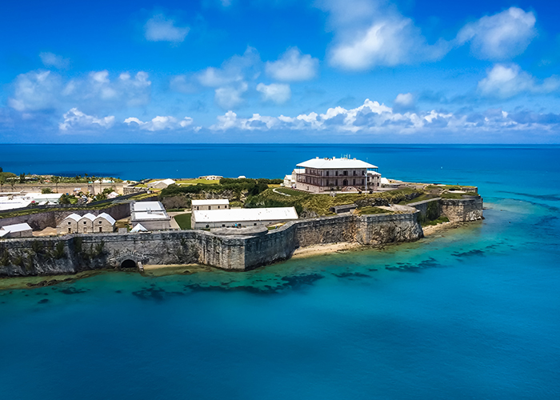

Slide 27
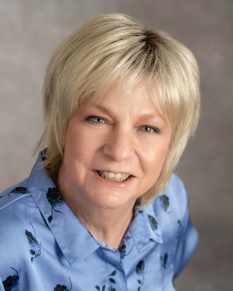
Your Organizer, Susan Barry, CTC Certified Travel Counselor. 2-year Degree 1984. Having earned my designation from The Travel Institute, the oldest and most respected non-profit certification organization in the travel industry.
These credentials require that I have at least five years of travel industry work experience, completed rigorous two-level certification and testing, and continue to fulfill stringent education requirements each year. Much like an accountant or doctor with their respective credentials, my CTC designation means that I am committed to upholding the highest standards of my profession while providing expert advice to my customers.
Susan Barry has earned certification in the travel industry showing a commitment to providing the highest quality travel experiences for travelers. The credentials listed here are the highest achievements possible.
Norwegian Cruise Lines, Susan Barry, Masters and PHD Certified Travel Agent

